Slide 1
Easy Feedback Token “EFT” was created to reward people who communicate useful and private feedback from www.EasyFeedback.com to improve products, services and processes of companies and institutions. “EFT” can be exchanged for products, services, cryptocurrencies or money at a market price.
www.EasyFeedbackToken.io

Slide 2
The problem
Companies need to control the bad experiences they have offered their clients
and receive ideas to improve their products and services.
This need arises because they have problems to:
1. Listening to their customers and identifying the dissatisfied ones
“A consumer who has had a negative experience with a company will tell an average of between 8 and 16 people”
2. Managing and increasing their satisfaction and gaining their loyalty
“8 out of 10 consumers indicate that they would be willing to pay more if it means receiving a better service”
3. Improving the customer´s services receiving from their employees in all touch points with the company
"Two out of three consumers changed company for products or services as a result of a bad customer service experience”
4. Building trust and differentiating themselves from the competition to increase sales
"78% of online customers recommend a brand to their friends when they have received adequate customer service”

Slide 3
The solution
Our mission is:
To facilitate the communication of useful feedback, promote its management
and improve the world.
To be the global “Hub” of Feedback
How will we do it?
By being the first option that consumers have to contact the company when:
The front line employees or internal customer service “fail”: the customer has used them and is not satisfied, the customer cannot find them, does not find them convenient or does not want to use them because they do not generate trust or the customer feels uncomfortable,
Before using other ways: complaint forms, consumer organisations, social networks and public forums…
Before going to the competition without saying why.
They want to send suggestions to improve products, services, processes or service from employees.
They want to send congratulations in appreciation of service received.
And rewarded this feedback with Easy Feedback Token "EFT" through the new concept we have created “the proof of feedback” (See Annex).

Slide 4
How does Easy Feedback works?
1. www.EasyFeedback.com
The gateway for sale our subscription to Easy Feedback PRO for business and legal advice... and the analysis of the data that is generated.
Consumers use Easy Feedback to send suggestions, congratulations, queries or complaints by email or by fax or mail completely free of charge to any company or institution in the world.
In few steps and without needing to register, they write a formal document and send their opinion with our forms (more than 2,800 different ones) that are adapted to the recipient company’s sector and the type of message they want to send.
Their feedbacks are not public and go directly to the directors, managers, owners ... of their favorite brands.
Unlike Facebook, Twitter … they are sent privately to the company’s management team.
2. Easy Feedback PRO
The Easy Feedback PRO subscription is a business tool to help to achieve customer care excellence.
A subscription to Easy Feedback PRO
that helps to improve your business
The tool that takes the "pulse" and improves the satisfaction of its customers by helping companies to:
1. Manage a bad customer experience avoiding negative comments on the Internet, complaint forms, consumer arbitration systems and the silent loss of customers.
2. Listen to your clients to build trust, transparency, differentiation and obtain their loyalty.
3. Improve the engagement of employees to enhance the experience that customers receive.
3. Legal advice
If the user of EasyFeedback.com is not satisfied with the resolution of their claim, we offer legal advice services.
A free service to send feedback
and defend your rights as a consumer
Your feedback is not public. They are sent privately to the management team of the companies.
If your complaint does not receive adequate treatment, our legal services offer the possibility of studying the possibilities of filing a judicial or extrajudicial claim charging success.
4. Use of EFTs
Sales generated with the use of EFTs in our online store and commissions generated by its use.
With the launch of the Easy Feedback Token, a Marketplace (online store) is being incorporated into the business model. In this online store we will offer:
1. Our own exclusive products and services,
2. Our customers products and services
3. and third party products and services so that Easy Feedback users can use their EFT tokens.
4. We give them the chance to exchange their EFT tokens for Amazon gift vouchers in all countries where it operates.
When a registered user in EasyFeedback and owns EFTs decides to exchange their EFTs,
a fee (a commission) will be charged.

Slide 5
Traction and marketing
1. www.EasyFeedback.com
Web running since August 2016.
230,000 feedbacks already sent to companies in 50 countries.
92,8 % found it Very interesting, Quite interesting or Somewhat interesting.
80,3 % told us that they are going to recommended or have already recommended it.
89,0 % said that they are going to use.
Bounce rate of 38,9%.
20,3% of users who visit the web send feedback.
2. Easy Feedback PRO
Product developed and in the market. Continuous product improvement interactions have been carried out for 3 years with two of our clients. 100 establishments have our services.
We have identified 180 potential sectors, but we are focusing on 63 potential sectors which we will contact at different phases of the commercialization.
In the fourth quarter of 2019, we will market in two of them: restaurants and car dealerships. Sectors where we already are with 15 clients that have tested and validated our product.
3. Legal advice
We launched this service in March 2019.
We already have clients that have contracted the service and we are improving the sales funnel.
It is currently running in Spain and soon, in Mexico.
The international implementation will be defined by the organic growth of the feedback sent through easyfeedback.com
4. Use of EFTs
As off today, the number of feedback sent daily ranges between 200 and 300.
With the launch of Easy Feeback Tokens and the process of internationalization of the service with translation into other languages, we expect an exponential growth of the number of feedback sent.
In July 2019 we started our marketing strategy: bounties program, referrals, advisors, registration in more than 120 pages of cryptocurrencies, contact with the speakers of more than 100 events related to the cryptocurrencies that we have located, launch of our 10 social networks in which we will interact and start our communication plan.
With the sale of our current products we will reach the break even in the first quarter of 2020.

Slide 6
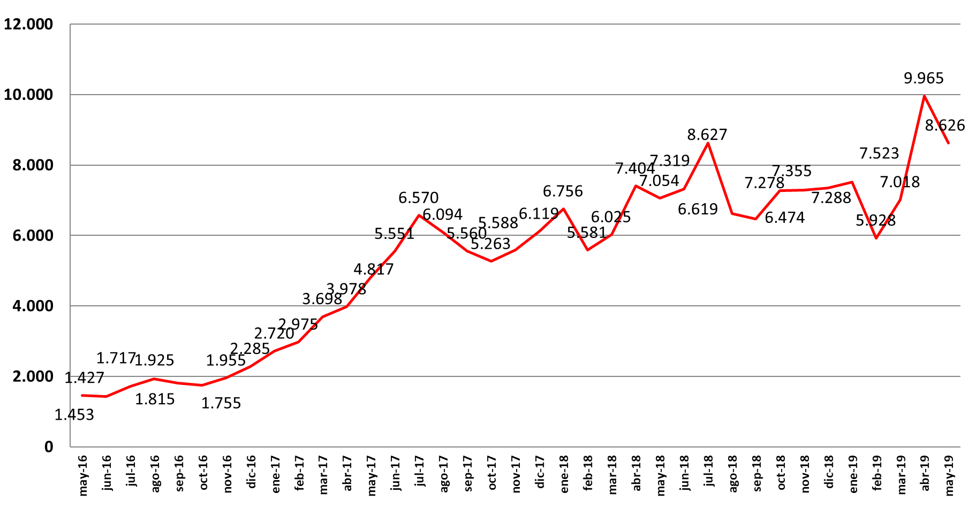
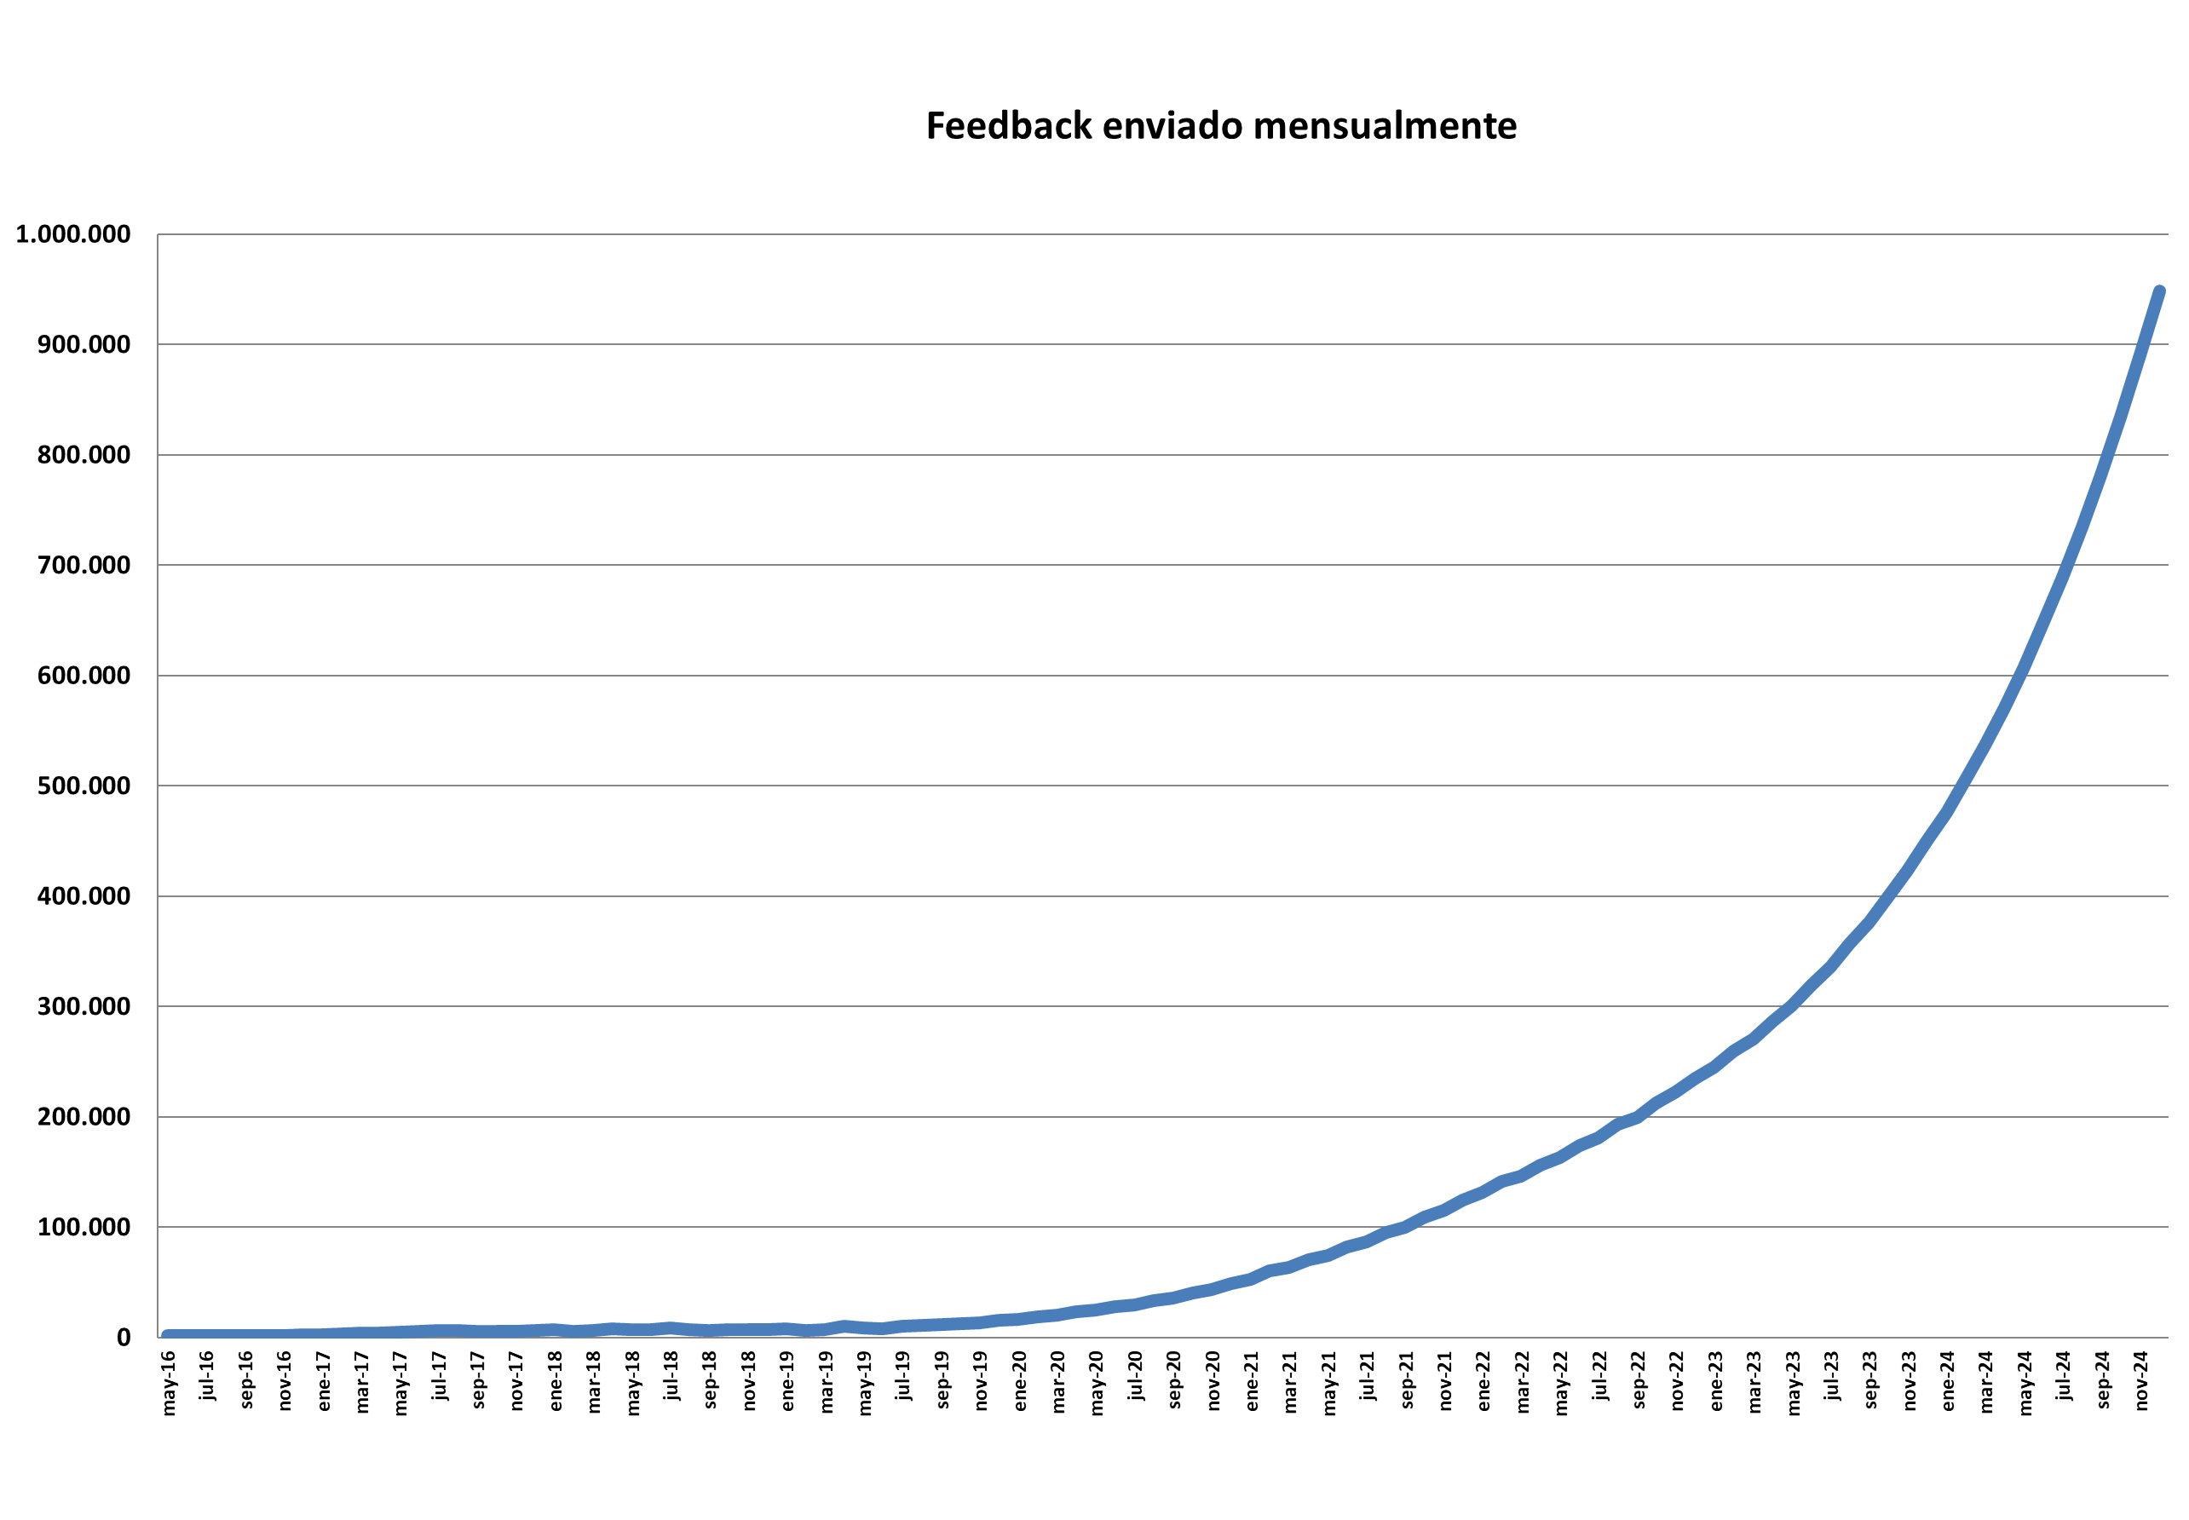
Feedback submission estimates
Feedback sent monthly
In Spanish since May 2016
Monthly feedback delivery forecasts
In 14 languages
Dec. 19 Dec. 20 Dec. 21 Dec. 22 Dec. 23 Dec. 24
With the funds raised we will start our international growth and expect an exponential increase of the sent feedback and consequently of the rest of the business units (Easy Feedback PRO subscription, legal advice and EFT marketplace).
To make the estimations we have used the same growth model that we have had in EasyFeedback.com in Spanish since May 2016. With an average monthly growth of 6.5%.
Each green line indicates the launch of EasyFeedback.com in a new language: English, German, Portuguese, Dutch, Italian, French, Polish, Russian, Korean, Japanese, Vietnamese, Chinese and Arabic
The increase in Feedback shipping we really believe will be much higher. The reason is that currently 86% of the fedback we send are complaints/claims with the
"proof of feedback" we will see a substantial increase in the sending of suggestions that currently only represent 8% of the feedback we send.

Slide 7
Market Competitors
Our “market competitors” are:
The traditional methods of collecting feedback: front line employees in direct contact with the customer; Free hotlines; Complaint forms; Company website; Mystery Shoppers; Personal interviews; Motivational groups; Surveys by telephone, in person, by post or email;
Internet portals/forums and Social networks (especially Facebook and Twitter) where a user can place their dissatisfaction on record;
Consumer Organisations.
The same goes for survey tools and
any other company that captures users' comments, including crypto projects such as rewardprotocol.com, revain.org or pivot.one.
All these options serve to capture feedback but no one offers the added value obtained with Easy Feedback, or can replace it. All of these must co-exist to enrich feedback with the customer.
We differentiate ourselves because:
No project rewards feedback (private, non-public, not anonymous) sent to companies.
Our portal is focussed principally on capturing and serving users. Sending a feedback is always independent of whether the company has contracted any of our products or not.
No competitor awards companies with a multichannel Certificate in “Customer Care Excellence”.
We base a large part of our strategy on our own “EasyFeedback” name together with the name of our customer.
The different “forms” (document templates) for complaints, congratulations, queries and/or suggestions for the 180 sectors we aim at contain sectorial specifications and even consumer legislation and can be used to initiate legal action.

Slide 8
Market Data
We are a great player in this market.
1. Our market is practically the same as the total number of companies and institutions per country.
2. We offer a unique value proposition in the world of feedback for: the characteristics of our feedback, the commitment acquired by companies with the patented seal to excellence in customer care and the possibility of being rewarded with Easy Feedback Tokens for the content thereof.
3. All this made reality with the incorporation of the blockchain to our native project.
1. Our market is practically the same as the total number of companies and institutions per country.
2. We offer a unique value proposition in the world of feedback for: the characteristics of our feedback, the commitment acquired by companies with the patented seal to excellence in customer care and the possibility of being rewarded with Easy Feedback Tokens for the content thereof.
3. All this made reality with the incorporation of the blockchain to our native project.

Slide 9
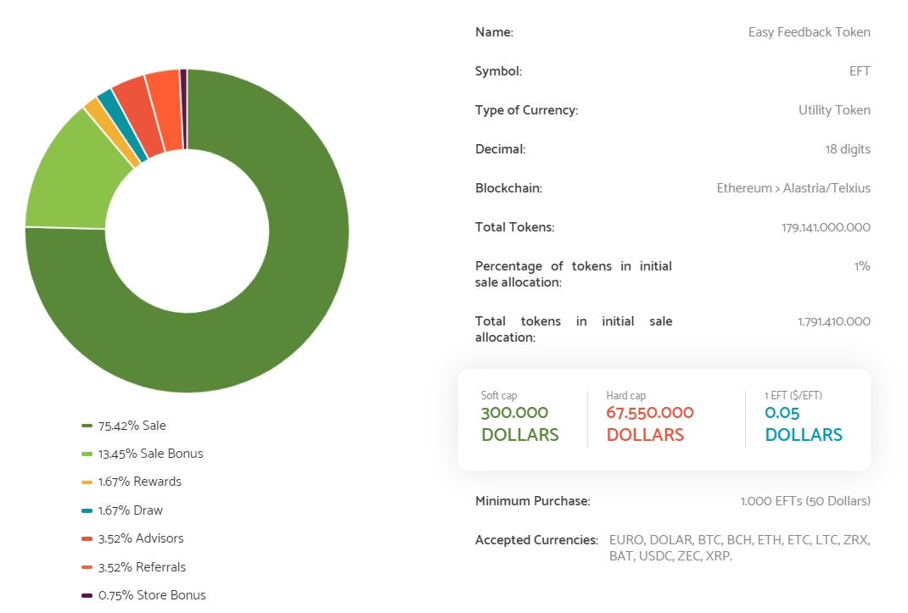
Financial model
Token Distribution

Slide 10
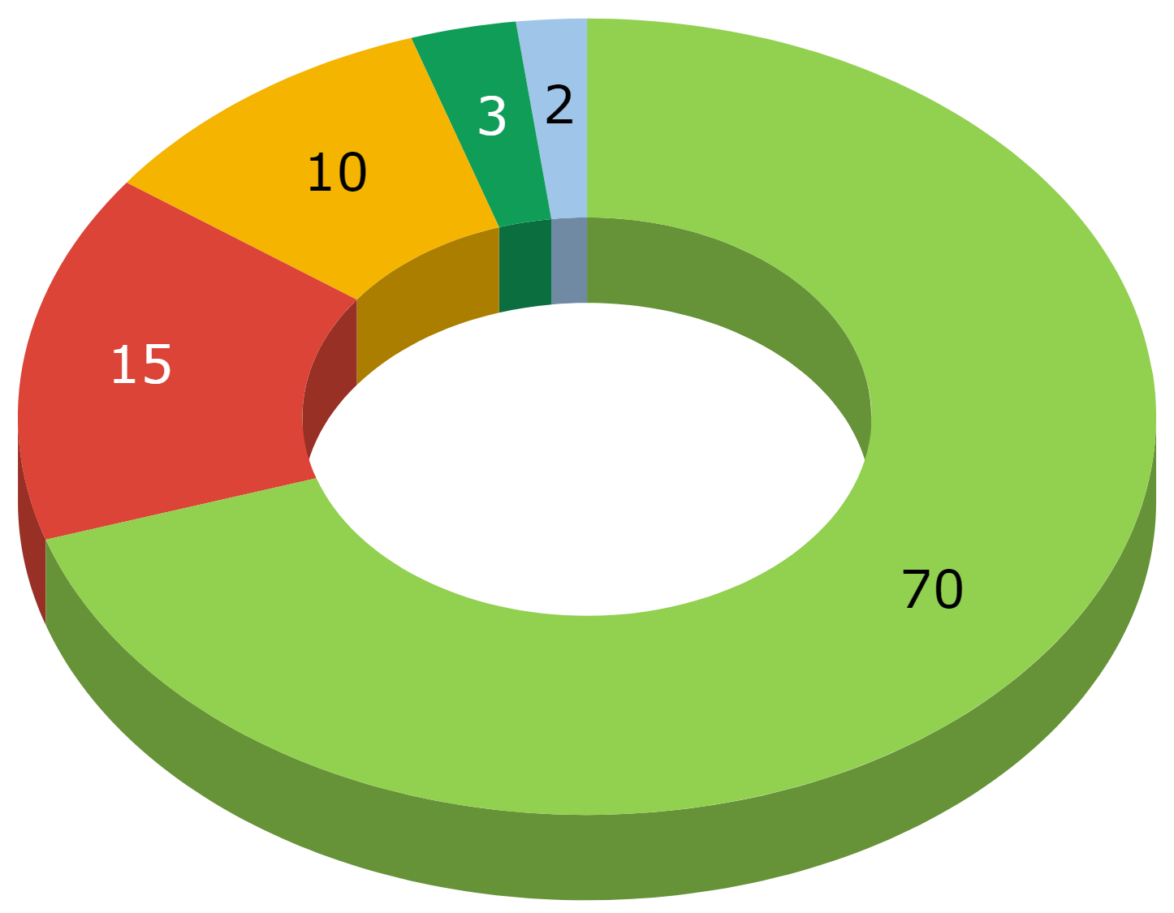
Financial model: Allocation of funds
(70%) DEVELOPMENT AND INNOVATION
Development of the integration of the Easy Feedback Tokens reward system in the process of sending feedback.
Creation of the internal, company and lawyer validator nodes.
New look & feel of EasyFeedback.com.
Development of the Easy Feedback online store.
Translation of the new version into different languages. The first languages the platform will be translated into will be the following: English, German, Portuguese, Dutch, Italian, French, Polish, Russian, Korean, Japanese, Vietnamese, Chinese and Arabic.
(15%) MARKETING and COMMERCIAL
Design and production of exclusive products for the online store or Marketplace where EFTs can be used.
Execution of the Marketing Plan and Commercial Plan.
(10%) GENERAL AND OPERATING EXPENSES
Purchase and maintenance of computer equipment.
Administrative costs of office and personnel.
(3%) EASY FEEDBACK PARTNERS
(2%) SOCIAL PROJECT
This is a project designed to facilitate the employability of people with mental disabilities by creating a business model that generates revenue through an activity accessible to their working capabilities.

Slide 11
Investment opportunity
The “EFT” token will be sold through an IEO (Initial Exchange Offering)
This paper is just for investors in Private sale Pre-IEO
BONUS 50%
1 EFT = 0.05 Dollars
Tokens per stage
EXCHANGE CONFIRMED
We are working to also list us in other exchanges.

Slide 12
Why to buy Easy Feedback Token "EFT"?

Slide 13
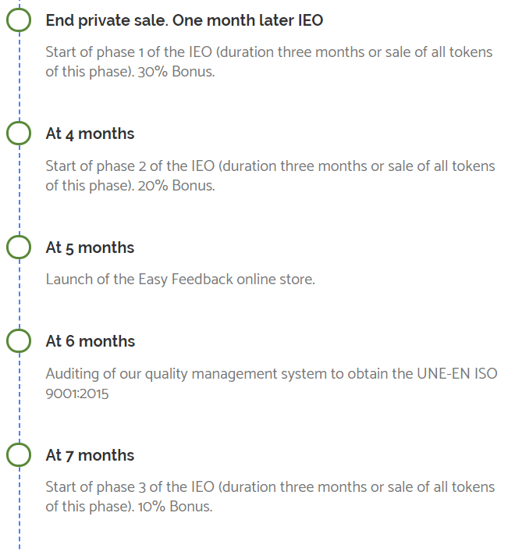
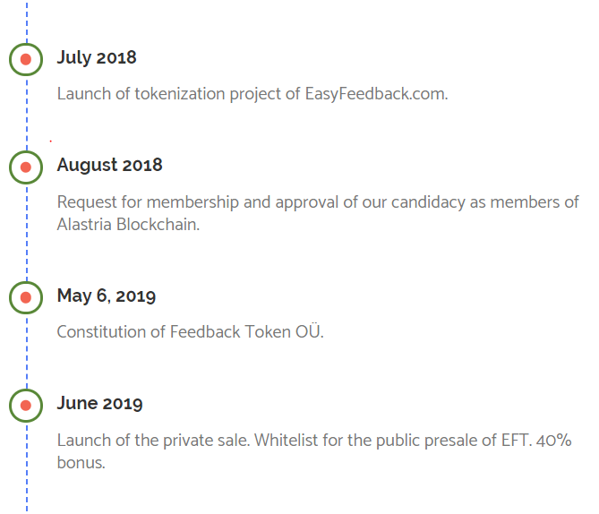
Road map

Slide 14
Team

Slide 15
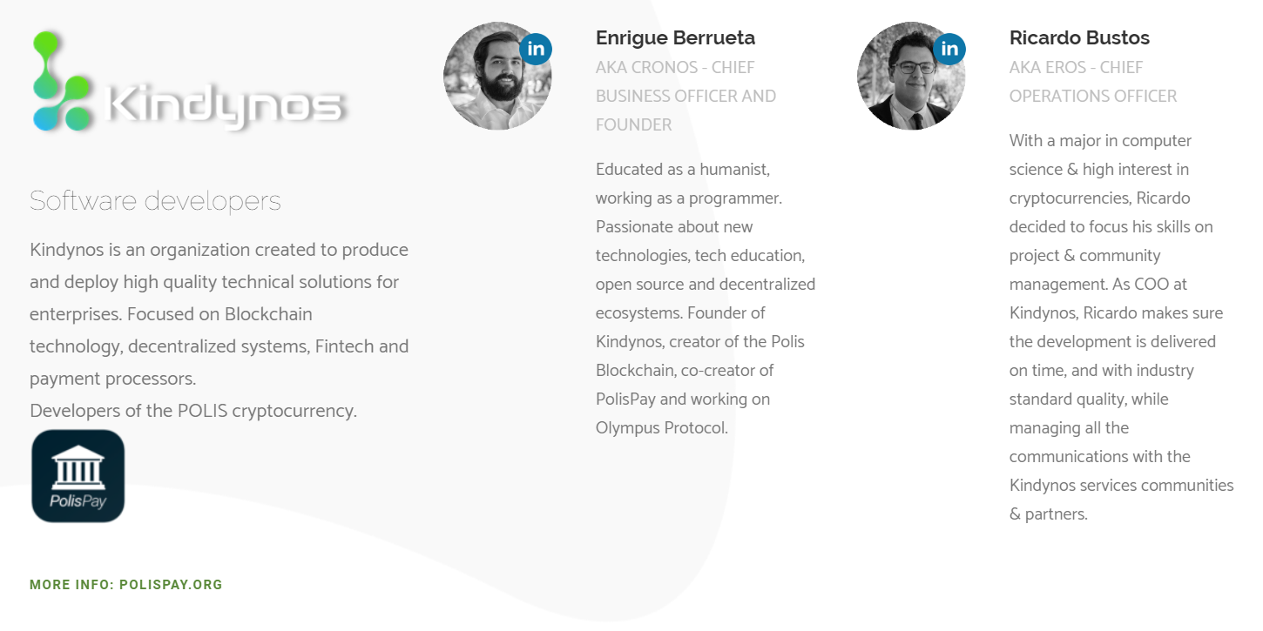
Partners
BLOCKCHAIN
EXCHANGE
BOUNTY

Slide 16
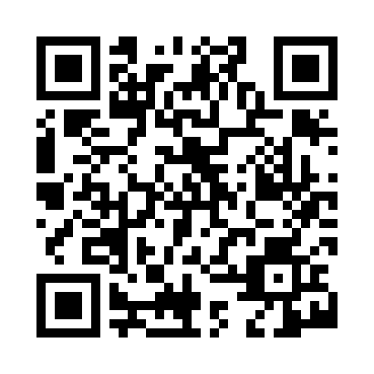
Easy Feedback Token Whitelist:
https://www.easyfeedbacktoken.io/whitelist_en/
Register to have priority in the purchase and indicate
that you are interested in the Private sale Pre-IEO
Contact us:
CEO. Honorio Ros
@. hros@easyfeedback.com
Follow us in:
www.EasyFeedbackToken.io
We are in:
Polígono industrial Mutilva baja, Calle V 26 Mutilva Baja 31192 Navarra, Spain
C/ Harju maakond, Tallinn, Lasnamäe linnaosa,
Majaka tn 26, 11412 Estonia

Slide 17
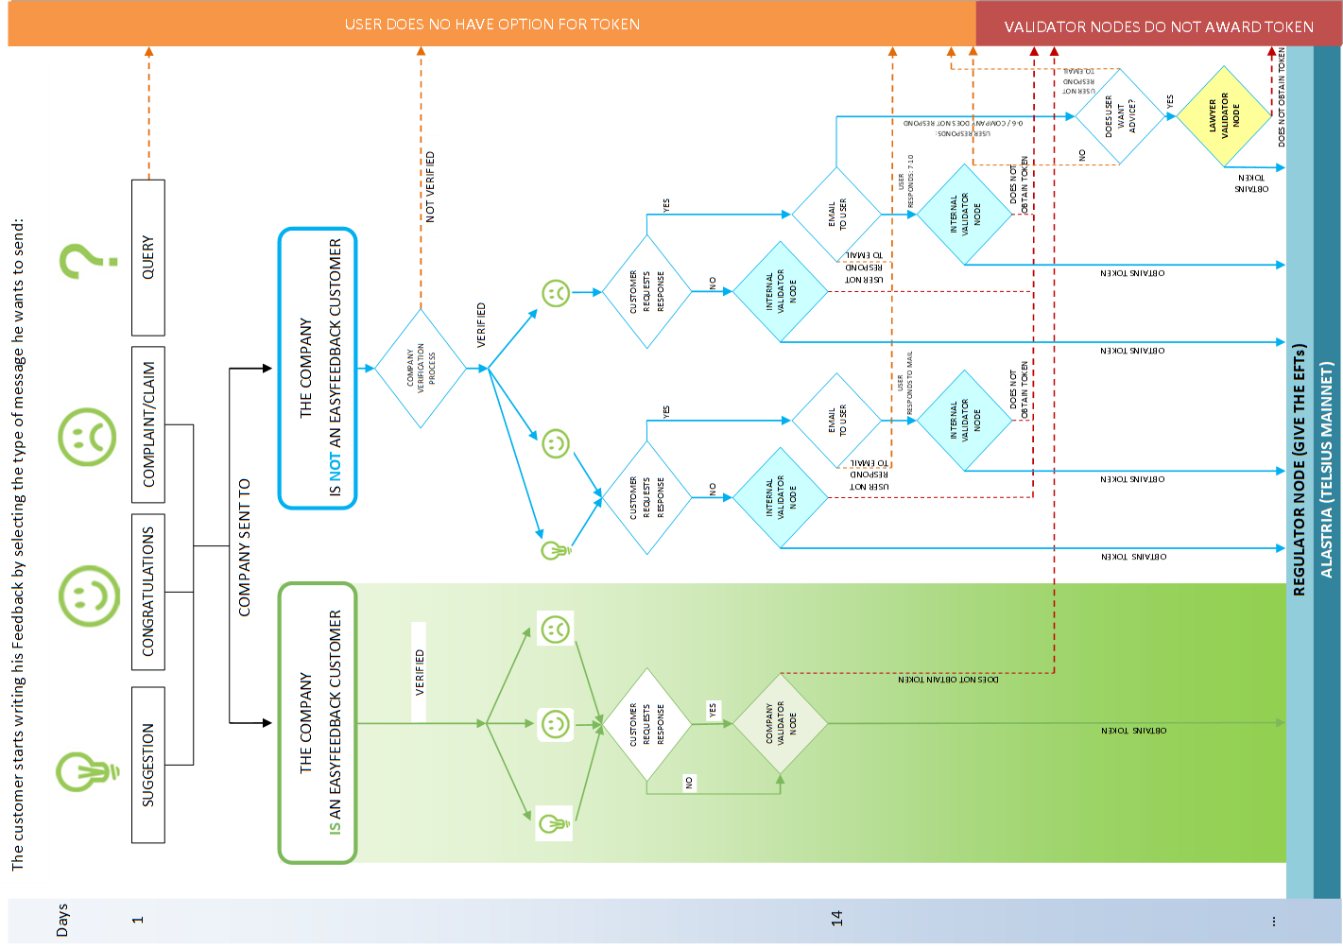
Award of EFTs to users and internal validator node
Page 40 of the white paper
Anexed: Proof of feedback

Slide 18
“Easy Feedback Token”
July 2019 Version 2.8
www.EasyFeedbackToken.io
Thank you for the time you are going to devote to studying our project. We hope to get your confidence.
Easy Feedback Token Team

